Slide 1

Week 4 Data Modeling using the Entity Relationship (ER) Model
Uzaira Saeed uzaira.saeed@google.com

Slide 2
Road Map
High Level Conceptual Model for DB Design
Sample DB Application
Entity Types, Entity Sets, Attributes & Keys
Relationship Types, Sets, Roles & Constraints
Weak Entity Types

Slide 3
Road Map…
ER Design for the Company Database
Diagram, Naming Conventions & Design
Relationship Types of Degree Higher than Two

Slide 4
High Level Conceptual Model for DB Design

Slide 5
Steps for Preparing Conceptual Model
Step 1: Gather & Collect Requirements
Collect Functional Requirements
Operations, Transactions
Can also be specified using DFDs, Sequence Diagrams & Scenarios
Collect Data Requirements
Data semantics etc…

Slide 6
Steps for Preparing Conceptual Model
Step 2: Make Conceptual Design of the DB
Make use of some Conceptual Model to prepare the App’s Conceptual Schema
It should fully reflect the User Requirements
Diagrammatically present:
Entities & their Relationships
Constraints
Must “not” include implementation details

Slide 7
Steps for Preparing Conceptual Model
Step 3: Implement the DB
It is the process of converting high-level Data Model to Implementation Data Model
This step is called “Logical Design” or “Data Model” Mapping
It results in DB Schema in the Implementation Data Model
Implementation is often automated or semi-automated within the DB Design tool
Select some Commercial DBMS for implementation

Slide 8
Steps for Preparing Conceptual Model
Step 4: Physical Design Phase
In this step the internal design structure, file organizations, indexes etc. are specified
In parallel, Application Programs are designed to utilize the DB

Slide 9
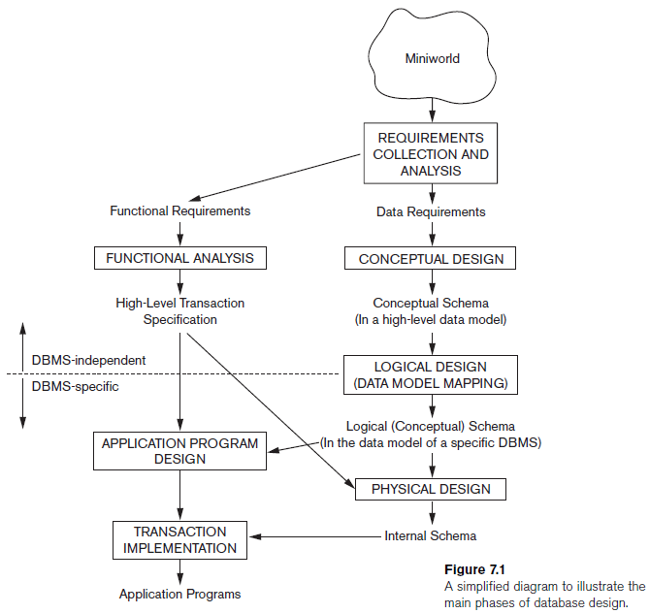
Steps for Preparing Conceptual Model

Slide 10
Case study: A Sample DB Application…

Slide 11
Company Database
We have to keep track of company’s Employees, Departments & Projects
Each Department has a unique number, name and a particular Manager
Department may have several locations
Department controls a number of Projects.
Each Project has a unique number, name and a single Location
We store each Employee’s Name, SSN, address, salary, gender and DOB
An Employee belongs to one Department but can work on several Projects which are not necessarily maintained by one Department
We keep track of current number of hours per week that an Employee works on each project
We also keep track of direct Supervisor of each Employee
We will keep track of Dependents of each Employee for insurance purposes
We will keep track of Dependent’s First Name, Gender, DOB and relationship to the Employee

Slide 12
ER Model CONCEPTS: Entity, Attribute & Key

Slide 13
Entity
Any real-world object about which we want to keep information is an “Entity”. OR
“Entity” is some independent object with existence in the real-world …
Each Entity has “Attribute(s)” that describe it’s characteristics or properties
Normally an Entity holds value for all of it’s attributes…

Slide 14
Entity
Employee’s Name: Aslam Talal with Employee ID: Emp1; NIC: 61105-1111201-1; address: H.No. 12, Street 84, Sector F-6/1; Islamabad; Gender: Male and DOB: 4/8/1989 is an Entity
Attributes for Employee are:
Employee’s Name, SSN, address, salary, gender and DOB

Slide 15
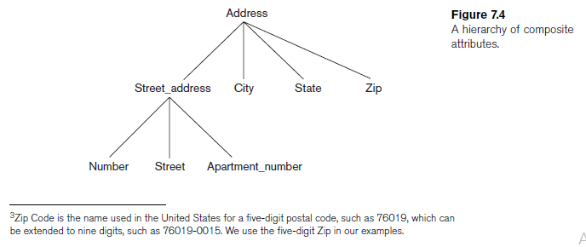
Types of Attributes
“Composite Attribute” can be divided in smaller sub-parts that can form a hierarchy
“Simple or Atomic Attributes” are not divisible

Slide 16
Types of Attributes
Single-Valued Attribute can only attain one single value for an entity e.g. Age
Miltivalued Attribute can attain multiple values for an entity e.g. College Degrees
Some attributes can determine value of another attribute. For example, in the case of DOB and Age, Age can be derivable from DOB. Hence,
Age is the “Derived Attribute” and
DOB is the “Stored Attribute”

Slide 17
Value Sets (Domain) of Attributes
Every Attribute has a domain
“Value Set: for the Name attribute can be a set of strings of alphabetic characters separated by blank characters, and so on…
Value sets are not displayed in ERD and are typically specified using the basic data types such as integer, string, Boolean etc…

Slide 18
Value Sets (Domain) of Attributes
Mathematically, an attribute A of entity set E whose value set is V can be defined as function from E to the power set P(V)
A : E → P(V)
value of attribute A for entity e as A(e)
NULL value is represented by the empty set.
For a composite attribute A, the value set V is the power set of the Cartesian product of P(V1), P(V2), ..., P(Vn), where V1, V2, ..., Vn are the value sets of the simple component attributes that form A:
V = P (P(V1) × P(V2) × ... × P(Vn))
The value set provides all possible values. Usually only a small number of these values exist in the database at a particular time.

Slide 19
More on Entities …
“Entity” is something which has real existence
“Entity Type” is collection of entities having common attribute
“Entity Set” is a set of entities of same entity type. It is a subset of Entity Type.
“Entity Type” describes the “schema” or “intention” and the complete “Entity Set” describes “extension” of the schema
If an “Entity Type” has no “Key”; it is called “Weak Entity Type”

Slide 20
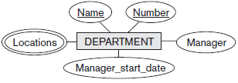
Initial Conceptual Design of Company DB
Each Department has a unique number, name and a particular Manager
Department may have several locations
Entity Type: DEPARTMENT
Attributes: Number, Name, Manager
Key Attribute(s): Number, Name
Multivalued Attribute(s): Location

Slide 21
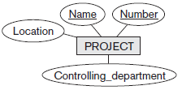
Initial Conceptual Design of Company DB
Department controls a number of Projects.
Each Project has a unique number, name and a single Location
Entity Type: PROJECT
Attributes: Number, Name, Location, Controlling Department
Key Attribute(s): Number, Name

Slide 22
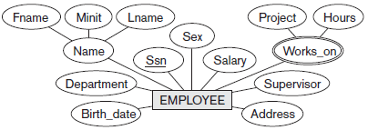
Initial Conceptual Design of Company DB
We store each Employee’s Name, SSN, address, salary, gender and DOB
An Employee belongs to one Department but can work on several Projects which are not necessarily maintained by one Department
We keep track of current number of hours per week that an Employee works on each project
We also keep track of direct Supervisor of each Employee
Entity Type: EMPLOYEE
Attributes: Name, SSN, address, salary, gender and DOB, Department, Supervisor
Key Attribute(s): SSN
Composite Attribute(s): Name, Address

Slide 23

Initial Conceptual Design of Company DB
We will keep track of Dependents of each Employee for insurance purposes
We will keep track of Dependent’s First Name, Gender, DOB and relationship to the Employee
Entity Type: DEPENDANT
Attributes: Employee, Dependent_Name, Gender, DOB, Relationship (to the Employee)
Composite Attribute(s): Name, Address

Slide 24
Relationship Types, Relationship SETS, Roles & STRUCTURAL CONSTRAINTS

Slide 25
Relationship Types, Sets & Instances
“Relationship” is an association among several entities
For example:
an Attribute of one Entity Type refers to another Entity Type. This reference is “Relationship”
For example: “Depart Name” in “Employee “Entity Type refers to “Department “Entity Type
“Relationship Type” R among n Entity Types E₁, E₂, …, E_{n} defines a set of associations among entities from these Entity Types.
Relationship Set is a Set of associations of the same Type.
Set of Relationship Instances r_{i}
Each r_{i} associates n individual entities (e₁, e₂, …, e_{n} )
Each entity e_{j} is a member of Entity Set E_{j}

Slide 26
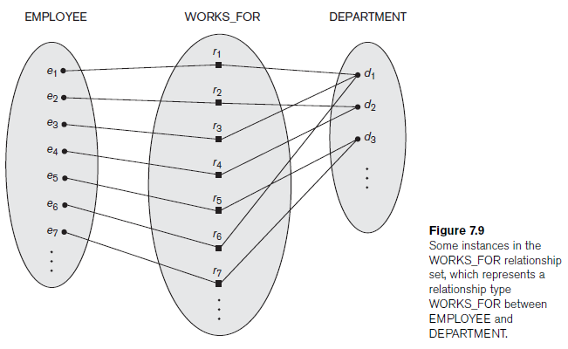
Relationship Types, Sets & Instances
Each “Relationship Instance” (r₁, r₂, …, r_{n} ) links entities of type EMPLOYEE to entities of type DEPARTMENT

Slide 27

Relationship Types, Sets & Instances
The relationship name is displayed in the diamond-shaped box
In ER diagrams, Relationship Types are displayed as diamond-shaped boxes, which are connected by straight lines to the rectangular boxes representing the participating Entity Types.
Relationship Types are useful for capturing/ expressing certain business rules

Slide 28
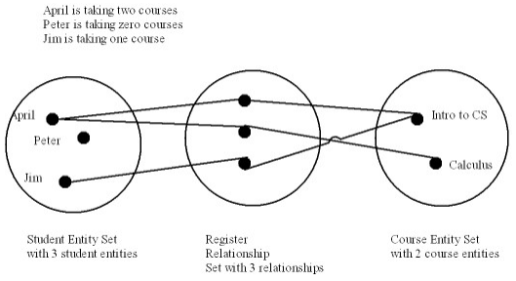
Relationship Types, Sets & Instances
Relationship Set is a collection of relationships all belonging to one relationship type.

Slide 29
Degree of Relationship Type
The degree of a relationship type is the number of participating entity types.
Works_For relationship is binary
it is also called a relationship of degree two
Relationship of degree three is called ternary
Example: Some Supplier “s” supplies Part p for the Project j Here, each relationship instance r_{i} associates three entities—a supplier s, a part p, and a project j

Slide 30
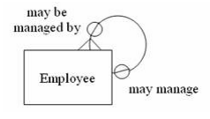
Recursive Relationship
Relationship always appear between occurrences in two different entities.
It is possible for the “same entity” to participate in the relationship. This is termed as ”Recursive Relationship”
Example: EMPLOYEE manages many Employees.

Slide 31
Constraints on Binary Relationship Type
Constraints limit the possible combinations of entities that participate in the corresponding relationship set.
Types of constraints on Binary Relationship
Cardinality Ratio
Participation Constraint
The above two constraints are also called the “Structural Constraints” of a relationship type

Slide 32
Cardinality Ratio Constraint
Cardinality Ratio for a Binary Relationship specifies the Maximum Number of relationship instances that one entity can participate in
There are three types of Cardinality Ratios

Slide 33
Cardinality Ratio Constraint
There are three types of Cardinality Ratios
One Department can have one HOD. This binary relationship is of cardinality ratio 1:1
In WORKS_FOR binary relationship; DEPARTMENT:EMPLOYEE is of cardinality ratio 1:N
Students can enroll for many subjects. A subject is enrolled by many Students; is a relationship of cardinality M:N

Slide 34
Participation Constraint
Participation Constraint for a Binary Relationship specifies the Minimum Number of relationship instances that one entity can participate in
Also called “Minimum Cardinality Constraint”
There are two types of Participation Constraints
Total Participation
Partial Participation

Slide 35
Participation Constraint
Total Participation
If a company policy states that an Employee must work for a Department, then an employee can exist iff it participates in at least one WORKS_FOR relationship
Total participation is also called “existence dependency”
It means a minimum of 1 and is represented by double line
Partial Participation
Every employee cannot manage a department. So the participation of EMPLOYEE in the MANAGES relationship type is partial since all employees cannot be Managers
It means a minimum of 0 and is represented by single line

Slide 36
Attributes of Relationship Types
Relationship Types may also have attributes…
Case 1: Binary + 1:1
HOD Manages a Department. In this case, Date_of_Joining is the Relationship Type Attribute. It can be accommodated in any of the two entities…
Case 2: Binary + 1:N
Student gets Registered in a Department. In this case, Date_of_Registration is the Relationship Type Attribute. It should be adjusted to Many side…
Case 3: Binary + M:N
Student registers many Subjects. In this case, Date_of_Registration is the Relationship Type Attribute. It should be adjusted to Many side…

Slide 37
Weak Entity Types

Slide 38
Weak Entity Types Overview
“Weak Entity” is an Entity Type that does not have the “Key” Attribute of their own
“Strong Entity Types” are the regular entity types that have a key attribute
“identifying relationship” exists between the Weak Entity Type and it’s “Owner Entity Type”

Slide 39
Weak Entity Types Overview
“Total Participation Constraint” OR “Existence Dependency” always exists between the Weak Entity Type and it’s “Owner Entity Type” because a weak entity cannot be identified without an owner entity.
Not every existence dependency results in a weak entity type.
Example: DRIVER_LICENSE entity cannot exist unless it is related to a PERSON entity even though it has its own key (License_number) thus it is not a weak entity.

Slide 40
Weak Entity Types Overview
“partial key” attribute can uniquely identify weak entities that are related to the same owner entity.
In ER diagrams, Weak Entity Type and its identifying relationship are distinguished by surrounding their boxes and diamonds with double lines
The partial key attribute is underlined with a dashed or dotted line.

Slide 41
ER Diagrams, Naming Conventions, and Design Issues

Slide 42
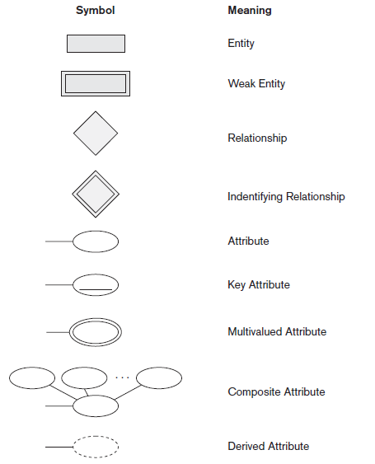
Notations of ER Diagram
Notes:
42
Inaccurate Estimate
Ineffective Control
Insufficient Tracking
Requirements not fulfilled

Slide 43
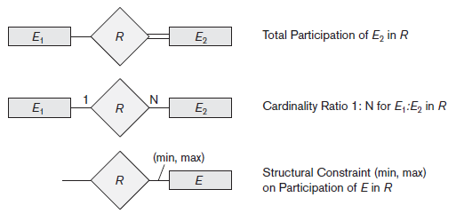
Notations of ER Diagram
Notes:
43
Inaccurate Estimate
Ineffective Control
Insufficient Tracking
Requirements not fulfilled

Slide 44
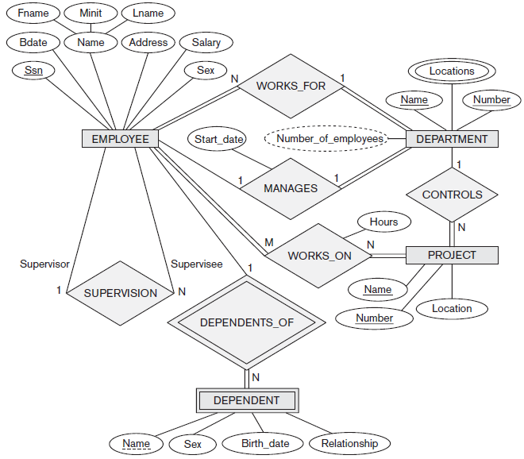
High- Level Conceptual Schema for the Company DB
Notes:
44
Inaccurate Estimate
Ineffective Control
Insufficient Tracking
Requirements not fulfilled

Slide 45
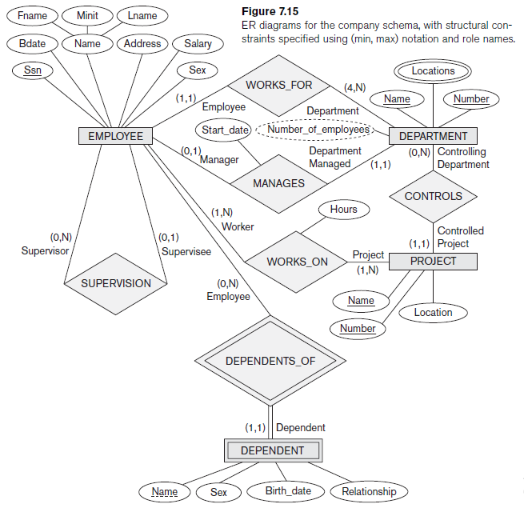
ERD for the Company Schema with Structural Constraints
Notes:
45
Inaccurate Estimate
Ineffective Control
Insufficient Tracking
Requirements not fulfilled

Slide 46
Relationship Types of Degree Higher than Two

Slide 47
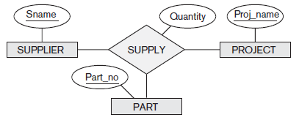
Choosing between Binary and Ternary (or Higher-Degree) Relationships
Figure displays schema for the SUPPLY relationship type
Relationship Set SUPPLY is a set of relationship instances (s, j, p), where s is SUPPLIER who is currently supplying a PART p to a PROJECT j.
Thus, a relationship type R of degree n will have n edges in an ER diagram, one connecting R to each participating entity type.

Slide 48
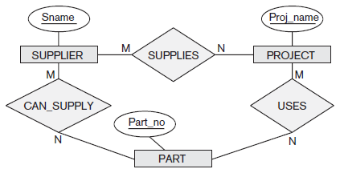
Choosing between Binary and Ternary (or Higher-Degree) Relationships
Figure shows an ER diagram for three binary relationship types CAN_SUPPLY, USES, and SUPPLIES.
Suppose that CAN_SUPPLY, between SUPPLIER and PART, includes an instance (s, p) whenever supplier s can supply part p (to any project)
USES, between PROJECT and PART, includes an instance ( j, p) whenever project j uses part p
SUPPLIES, between SUPPLIER and PROJECT, includes an instance (s, j) whenever supplier s supplies some part to project

Slide 49
Choosing between Binary and Ternary (or Higher-Degree) Relationships
The existence of three relationship instances (s, p), ( j, p), and (s, j) in CAN_SUPPLY, USES, and SUPPLIES, respectively, does not necessarily imply that an instance (s, j, p) exists in the ternary relationship SUPPLY, because the meaning is different.
It is often tricky to decide whether a particular relationship
should be represented as a relationship type of degree n or should be broken down into several relationship types of smaller degrees.
The designer must base this decision on the semantics or meaning of the particular situation being represented.
The typical solution is to include the ternary relationship plus one or more of the binary relationships, if they represent different meanings and if all are needed by the application.

Slide 50
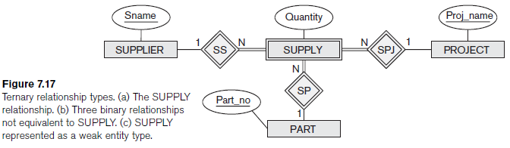
Choosing between Binary and Ternary (or Higher-Degree) Relationships
Some DB design tools are based on variations of the ER model that permit only binary relationships.
Ternary relationship such as SUPPLY must be represented as a weak entity type, with no partial key and with three identifying relationships. The three participating entity types SUPPLIER, PART, and PROJECT are together the owner entity types
Thus, any entity in the weak entity type SUPPLY is identified by the combination of its three owner entities from SUPPLIER, PART, and PROJECT.

Slide 51
Choosing between Binary and Ternary (or Higher-Degree) Relationships
The ternary relationship can be represented as a regular entity type by introducing an artificial or surrogate key
Thus, a key attribute Supply_id could be used for the supply entity type, converting it into a regular entity type
Three binary N:1 relationships relate SUPPLY to the three participating entity types

Slide 52
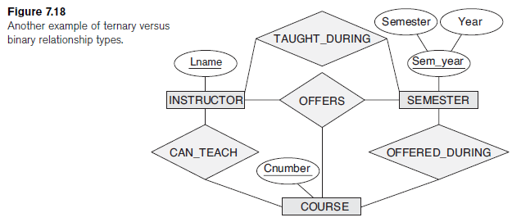
Choosing between Binary and Ternary (or Higher-Degree) Relationships
Ternary relationship type OFFERS represents information on instructors offering courses during some semester
We have; Relationship instance (i, s, c) where INSTRUCTOR i offers COURSE c during SEMESTER s.

Slide 53
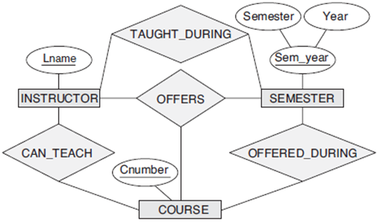
Choosing between Binary and Ternary (or Higher-Degree) Relationships
CAN_TEACH relates a course to the instructors who can teach that course
TAUGHT_DURING relates semester to instructors who taught some course during that semester
OFFERED_DURING relates semester to the courses offered during that semester by any instructor

Slide 54
Choosing between Binary and Ternary (or Higher-Degree) Relationships
Instances of TAUGHT_DURING and OFFERED_DURING from the instances in OFFER S, but we cannot infer the instances of CAN_TEACH; therefore, TAUGHT_DURING and OFFERED_DURING are redundant and can be left out.
in general three binary relationships cannot replace a ternary relationship,
they may do so under certain additional constraints.
If CAN_TEACH relationship is 1:1 (an instructor can teach one course, and a course can be taught by only one instructor), then the ternary relationship OFFERS can be left out because it can be inferred from the three binary relationships CAN_TEACH, TAUGHT_DURING, and OFFERED_DURING.
The schema designer must analyze the meaning of each specific situation to decide which of the binary and ternary relationship types are needed.

Slide 55
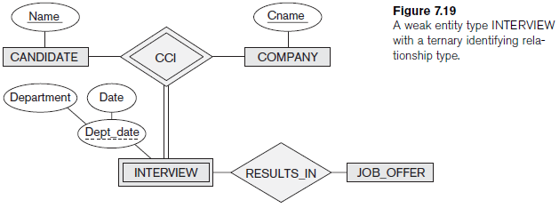
Choosing between Binary and Ternary (or Higher-Degree) Relationships
it is possible to have a weak entity type with a ternary (or n-ary) identifying relationship type with several owner entity types.
In this example DB keeps track of candidates interviewing for jobs at various companies
candidate can have multiple interviews with the same company (for example or with different company departments or on separate dates), but a job offer is made based on one of the interviews.
Here, INTERVIEW is represented as a weak entity with two owners CANDIDATE and COMPANY, and with the partial key Dept_date.
An INTERVIEW entity is uniquely identified by a candidate, a company, and the combination of the date and department of the interview.

Slide 56
Constraints on Ternary (or Higher-Degree) Relationships
The relationship set of SUPPLY is a set of relationship instances (s, j, p), where s is a SUPPLIER, j is a PROJECT, and p is a PART.
Suppose the constraint: only one supplier supplies a particular part to a particular project
In this case, we place 1 on the SUPPLIER participation, and M, N on the PROJECT, PART participation.
This specifies the constraint that a particular ( j, p) combination can appear at most once in the relationship set because each (PROJECT, PART) combination uniquely determines a single supplier.
Hence, any relationship instance (s, j, p) is uniquely identified in the relationship set by its ( j, p) combination. This makes ( j, p) a key for the relationship set.

Slide 57
Constraints on Ternary (or Higher-Degree) Relationships
In a relationship, if we have a 1 specified on the Entity Type; it’s Key is not required to be part of the identifying key for the relationship set.
If all three cardinalities are M or N, then the key will be the combination of all three participants.

Slide 58
Q & A
?

Slide 59
Thank You

